Slide 1
Secure Data Hiding In Images Using Steganography
CAPSTONE PROJECT
Presented By: Kashyap Ghodasara
Student Name : Kashyap Ghodasara
College Name & Department : Atmiya University – Diploma in Computer Engineering

Slide 2
OUTLINE
Problem Statement
Technology used
Wow factor
End users
Result
Conclusion
Git-hub Link
Future scope

Slide 3
Problem Statement
Keeping data safe is very important today. Normal encryption can be detected easily. Our project uses steganography to secretly hide messages inside images. This makes communication secure and unnoticed.

Slide 4
Technology used
Programming Language: Python
Libraries:
OpenCV for image processing
Platform: Cross-platform (Windows/Linux)
Tools: Visual Studio Code

Slide 5
Wow factors
Implements robust LSB steganography that embeds both the passcode and message length in the image header.
Uses lossless JPG format to preserve hidden data integrity.
Combines advanced image processing techniques with secure data transmission.
This is an Efficient technique for data hiding.

Slide 6
End users
General users looking for enhanced digital security.
Security professionals and cybersecurity enthusiasts.
Students and researchers interested in data privacy and steganography.
Journalists, activists, and government agencies needing secure communication channels.

Slide 7
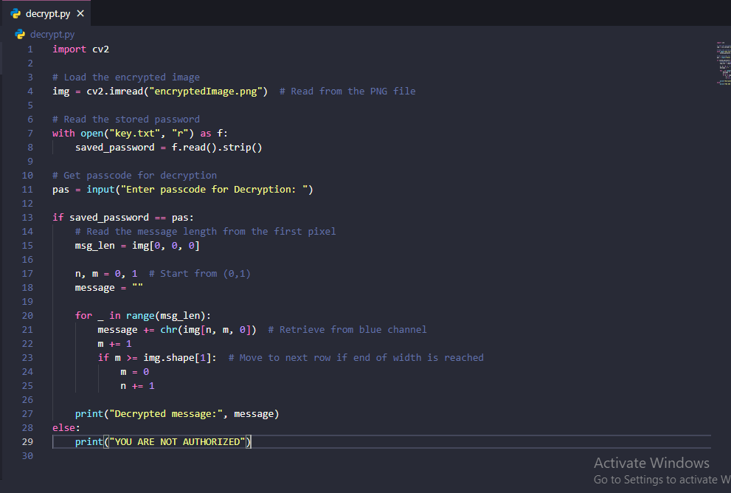
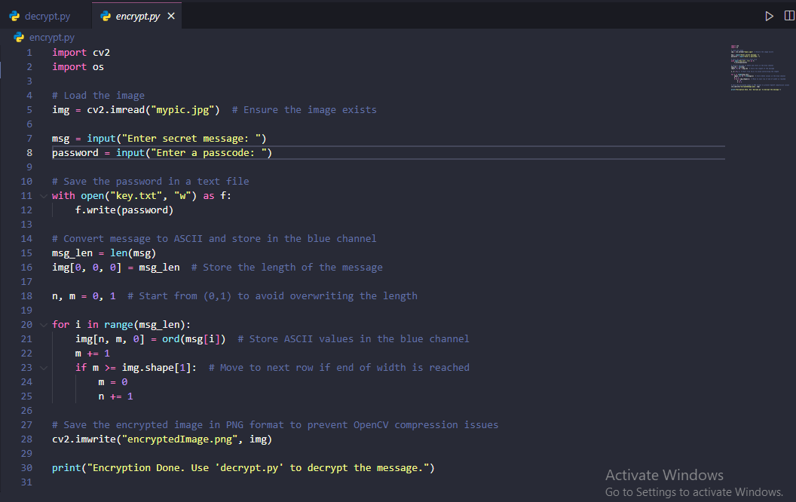
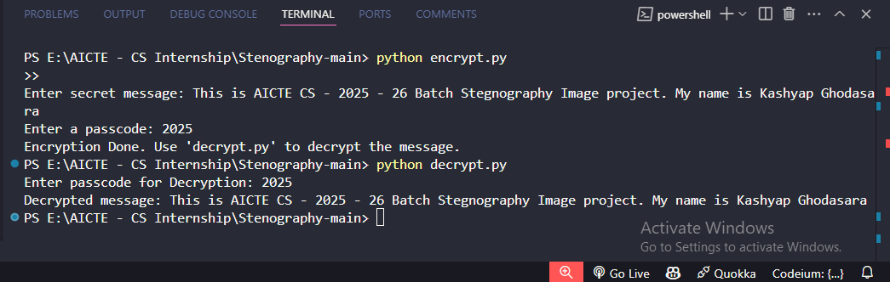
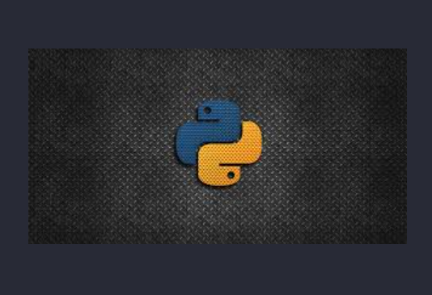
Results

Slide 8
Conclusion
Our project successfully demonstrates a novel approach to data security by hiding information within an image using LSB steganography.
The technique is both secure and undetectable, thanks to embedding critical header information such as passcode and message lengths.
This project contributes to the broader field of digital privacy and secure data transmission.

Slide 9
GitHub Link
https://github.com/Kashyapghodasara/Stegnography-AICTE

Slide 10
Future scope(optional)
Support for multiple image formats and higher resolution images.
Extend the approach to video steganography for dynamic data hiding.
Incorporate advanced encryption algorithms to further secure the hidden message.
Develop a web-based or mobile application for broader accessibility.
Explore automated detection and extraction tools for steganographic content.

Slide 11
THANK YOU

